Slide 1
Life Expectancy Prediction
Karthik Sakthikanesan
4550514

Slide 2
Goal of the Project
This is a regression problem.
The primary goal was to create a model that could predict the average life expectancy of a country.
In addition to this I wanted to find out how important each factor was in determining average life expectancy of a country whether that be in a negative or positive way.

Slide 3
The Dataset
The dataset was scraped from the Global Health Observatory (GHO) website. The GHO is an organisation within the World Health Organisation (WHO). It was found on kaggle.
There are sixteen different features.
These features can be broadly classified into:
  Immunization factors
  Mortality factors
  Economical factors
  Social factors

Slide 4
The Dataset
There are 194 countries included in this dataset which is all the countries officially recognised by the WHO.
Most countries have data for every year from 2000-2015 with a few exceptions such as South Sudan.
The average life expectancy for the countries still in the dataset is 71.8, the minimum is 48.1 and the maximum is 89.

Slide 5
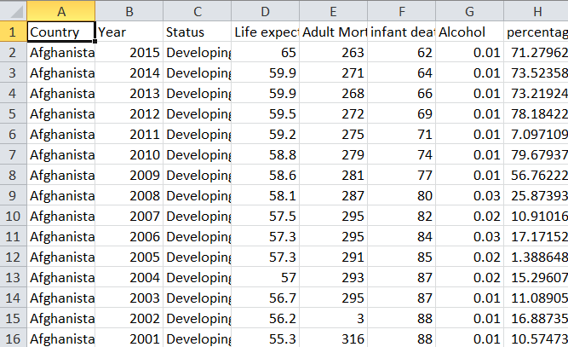
The Dataset

Slide 6
Features
Status – if the nation is developed or developing
Adult.Mortality – the probability of dying between 15 and 60 years old per 1000 population
infant.deaths – number of infant deaths per 1000 population
Alcohol – alcohol consumption in litres per capita per year
percentage expenditure - Expenditure on health as a percentage of Gross Domestic Product per capita(%)
Hepatitis B - Hepatitis B (HepB) immunization coverage among 1-year-olds (%)
Measles – reported number of measles cases per 1000 population
BMI – Average body mass index of the entire population

Slide 7
Features
under-five deaths - Number of under-five deaths per 1000 population
Polio - Polio (Pol3) immunization coverage among 1-year-olds (%)
Total expenditure - General government expenditure on health as a percentage of total government expenditure (%)
Diphtheria - Diphtheria tetanus toxoid and pertussis (DTP3) immunization coverage among 1-year-olds (%)
HIV/AIDS - Deaths per 1000 live births HIV/AIDS (0-4 years)
GDP- Gross Domestic Product per capita (in USD)
Population – population of the country

Slide 8
Features
thinness 1-19 years - Prevalence of thinness among children and adolescents for Age 10 to 19 (% )
thinness 5-9 years - Prevalence of thinness among children and adolescents for Age 5 to 9 (% )
Income composition of resources - Human Development Index in terms of income composition of resources (index ranging from 0 to 1)
Schooling – Number of years of schooling

Slide 9
Cleaning
Only used the data from 2014. This is because when all the years are used, entries from the same country tend to be in the same leaf (in the case of randomForest. Due to this the error was very low but the model wasn’t useful.
A few countries had missing columns. The lesser developed countries tended to have more. Any country with missing values was removed.
I was left with 171 observations (countries) out of the original 194 countries.

Slide 10
Algorithms Used
Linear regression – RMSE=3.28
Polynomial regression – RMSE=2.92
For both these algorithms, I used a function to compute all the possible subsets for the features and return the best subset.
The RMSE for all models used was done using 10 fold cross-validation.

Slide 11
Random Forest
The first model I made used all the features that were available.
I tuned it using grid search as there was only one hyper-parameter that needed to be tuned, namely the number of variables used at each branch.
The RMSE was 2.54.

Slide 12
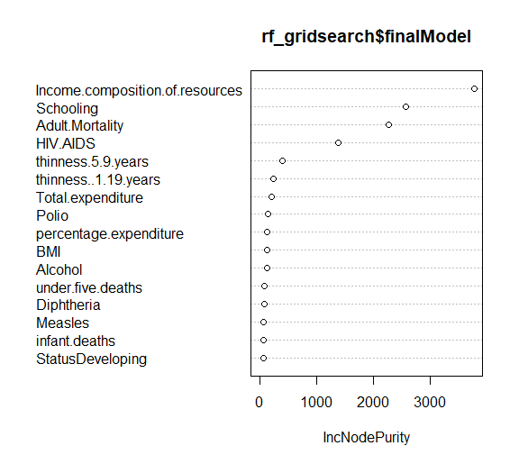
Random Forest

Slide 13
Random Forest
The subset of the features with the least errors had an RMSE of 2.51 which was down from 2.54 when all of the features are used.
The number of features is down to 5 from the original 16.

Slide 14
Important Features (in order)
Income composition of resources - Human Development Index in terms of income composition of resources (index ranging from 0 to 1)
Schooling – Number of years of schooling
Adult.Mortality – the probability of dying between 15 and 60 years old per 1000 population
HIV/AIDS - Deaths per 1000 live births HIV/AIDS (0-4 years)
thinness 5-9 years - Prevalence of thinness among children and adolescents for Age 5 to 9 (%)

Slide 15
QUESTIONS?

